Slide 1

SMART
CLUSTER
Nishadh Hussain M
PET 0043

Slide 2
Navigation Guide
S.NO | Outline
1 | Synopsis
2 | Process Map
3 | Call Data
4 | Navigation Data
5 | Music Data
6 | Datasets
7 | App Interface
8 | nRF52 Debug terminal
9 | Incoming data in Docklight
10 | Pros & Cons

Slide 3
Synopsis
Date | 15/11/2023
Manage the data flow from app to nRF52.
Navigate the data through the nRF52 to XMC1400 via SPI.
Properly transmit the received data to i.MX6 via UART.
i.MX6 UI changes as per the data from the app

Slide 4
Process map
Date | 15/11/2023
Transmit the phone call,navigation and music datas.
By UART Transmit the app data send by nRF52
Display
App
nRF52
XMC1400
i.MX6
.01.XX
Transmit those datas send by app via SPI to XMC1400
By the help of RS232 connect to i.MX6
Receives the corresponding data that user sends via app

Slide 5
Call Data
Date | 15/11/2023
Incoming call 1 - 1,5,39,0,5,50,0,1,5,'P','I','X','E','L',0,0,0,0,0,0,0,0,0,0,2,10,9,8,7,6,5,4,3,2,1,0,0,0,0,0,0,0,0
Incoming call 2 - 1,5,39,0,5,50,0,1,6,'E','X','P','E','R','T',0,0,0,0,0,0,0,0,0,2,12,9,9,8,8,7,7,6,6,5,5,4,4,0,0,0,0,0
Ongoing call 1 - 1,5,39,0,9,50,1,1,6,'P','I','X','E','L',0,0,0,0,0,0,0,0,0,0,2,10,9,8,7,6,5,4,3,2,1,0,0,0,0,0,0,0,0
Ongoing call 2 - 1,5,39,0,9,50,1,1,5,'E','X','P','E','R','T',0,0,0,0,0,0,0,0,0,2,12,9,9,8,8,7,7,6,6,5,5,4,4,0,0,0,0,0
End Call - 1,5,39,0,17,50,2,1,0,0,0,0,0,0,0,0,0,0,0,0,0,0,0,0,2,0,0,0,0,0,0,0,0,0,0,0,0,0,0,0,0,0,0
Missed call - 1,5,39,0,33,50,0,1,0,0,0,0,0,0,0,0,0,0,0,0,0,0,0,0,2,0,0,0,0,0,0,0,0,0,0,0,0,0,0,0,0,0,0

Slide 6
Navigation Data
Date | 15/11/2023
Navigation Data 1 - 1,9,32,0,129,1,9,'i','n',' ','1','0','0','0',' ','m',0,2,5,'1','3',' ','K','m',0,0,0,0,0,3,2,47,0,0,0,0
Navigation Data 2 - 1,9,32,0,130,1,8,'i','n',' ','7','4','0',' ','m',0,0,2,4,'1',' ','K','m',0,0,0,0,0,0,3,2,10,0,0,0,0
Navigation Data 3 - 1,9,32,0,131,1,7,'i','n',' ','3','0',' ','m',0,0,0,2,6,'9','.','5',' ','K','m',0,0,0,0,3,1,50,0,0,0,0
Navigation Data 4 - 1,9,32,0,132,1,8,'i','n',' ','5','0','0',' ','m',0,0,2,4,'8',' ','K','m',0,0,0,0,0,0,3,1,35,0,0,0,0

Slide 7
Music Data
Date | 15/11/2023
Music_Player_data 1 - 1,17,18,0,3,50,1,6,'s','o','n','g',' ','1',3,45,2,25,0,0,0,0
Music_Player_data 2 - 1,17,18,0,3,40,1,6,'s','o','n','g',' ','1',3,45,3,22,0,0,0,0
Music_Player_data 3 - 1,17,18,0,1,40,1,6,'s','o','n','g',' ','1',3,45,3,22,0,0,0,0
Music_Player_data 4 - 1,17,19,0,3,30,1,7,'s','o','n','g','@','1','2',53,45,42,25,0,0,0,0
Music_Player_data 5 - 1,17,19,0,3,50,1,7,'s','o','n','g','@','1','2',53,45,23,22,0,0,0,0
Music_Player_data 6 - 1,17,19,0,1,50,1,7,'s','o','n','g','@','1','2',53,45,23,22,0,0,0,0

Slide 8
Datasets
Date | 15/11/2023
Data Structure Overview:
Phone: On state (1), Type (5), Size (39), Reserved (0)
Navigation: On state (1), Type (9), Size (32), Reserved (0)
Music: On state (1), Type (17), Size (19), Reserved (0)
Size Calculation for On State:
Phone: 4 bytes data used (4 + 1 = 5)
Navigation: 8 bytes data used (8 + 1 = 9)
Music: 16 bytes data used (16 + 1 = 17)

Slide 9
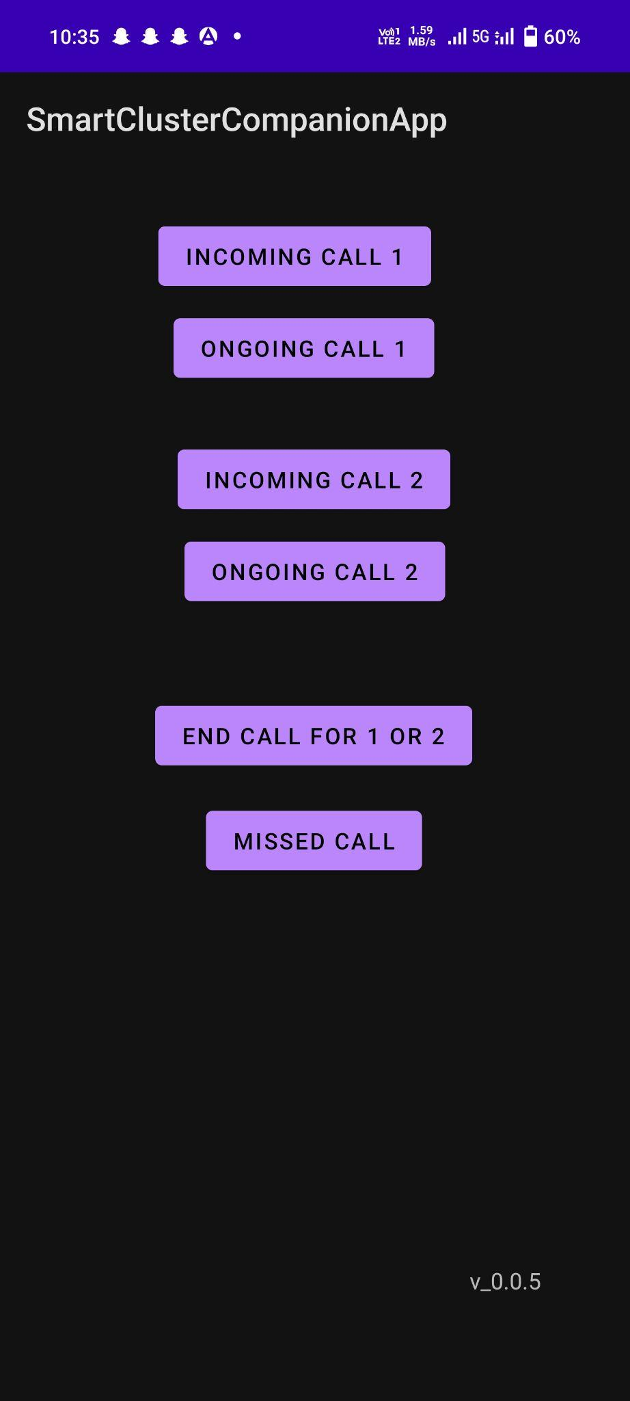
App Interface
Date | 14/11/2023
Date | 15/11/2023

Slide 10
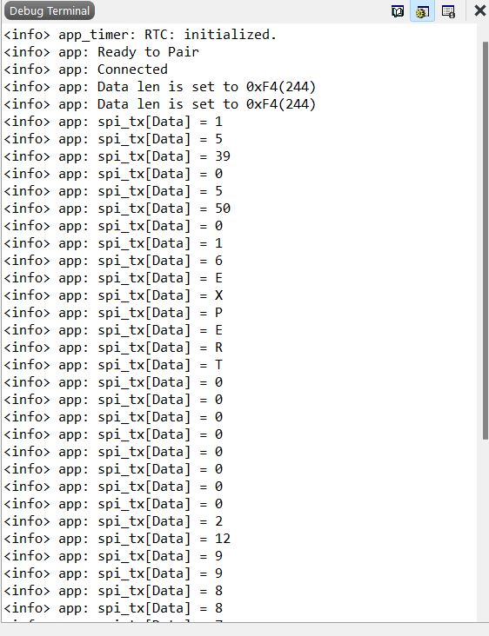
nRF52 debug terminal
Date | 15/11/2023

Slide 11
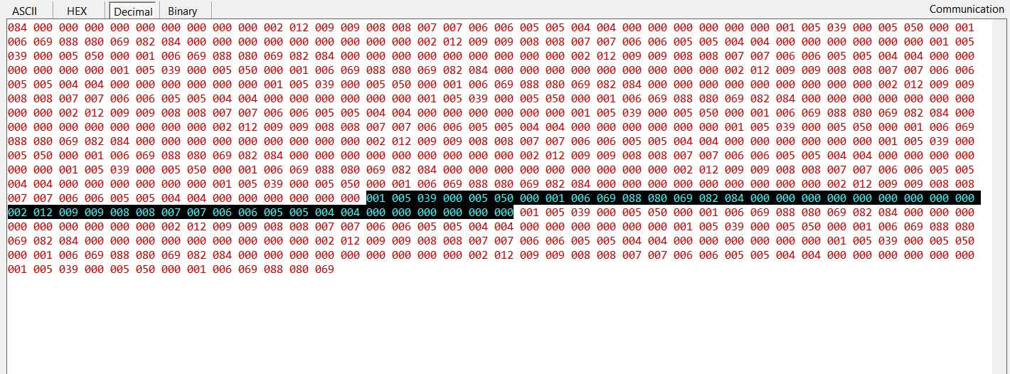
Incoming data in Docklight
Date | 15/11/2023

Slide 12
Pros
Date | 15/11/2023
Wireless Connectivity
Flexible Data Transmission
Enhanced Reliability
Energy Efficiency
Security and Privacy

Slide 13
Cons
Date | 15/11/2023
Synchronization Challenges
Potential for Data Loss or Corruption
Increased Latency

Slide 14
THANK
YOU

